Slide 1


Interactive Dashboard for Real-time Equity Analysis
Hackathon (ENGI’24)
StockCrafters:-
Arkadeep, Anchal, Shivani

Slide 2
Contents
Problem Statement
Introduction
Problem Statement
Objective
Solution overview
Key Features
Focus
Technology Stack
Features and Functionality
Demo
Scalability & Future Enhancements:
Challenges & Learning
Conclusion

Slide 3
Problem Statement
Growing importance of ESG factors and responsible investing.
The need for real-time data to make informed decisions.
Role of market sentiment driven by social media and news.

Slide 4

Objective
To develop a tool that consolidates real-time data and provides investors with a holistic view of stock performance.

Slide 5
Key Features
User-friendly interface for real-time sustainability and market sentiment data.
Interactive dashboard with diverse data analytics.
Scalability for future enhancements.

Slide 6
Focus
U.S. stock market
Market Capitalization
Market indicators
* Beta
* P/E ratio

Slide 7
Technology Stack:
Frontend: (HTML, CSS, JavaScript)
Backend: (Flask framework for Python)
APIs: (Yahoo finance (yfinance) API for real time data fetching)
Database: (JSON)

Slide 8
Features & Functionality:
Real-time Data Aggregation:
Pulls data from authorized sources for accurate insights.
Includes sustainability scores and financial metrics.
Market Sentiment Analysis:
Incorporates indicators like Beta .
Analysis of market trends.
User Dashboard:
Interactive charts for stock performance.
Customizable views for personalized analysis.

Slide 9
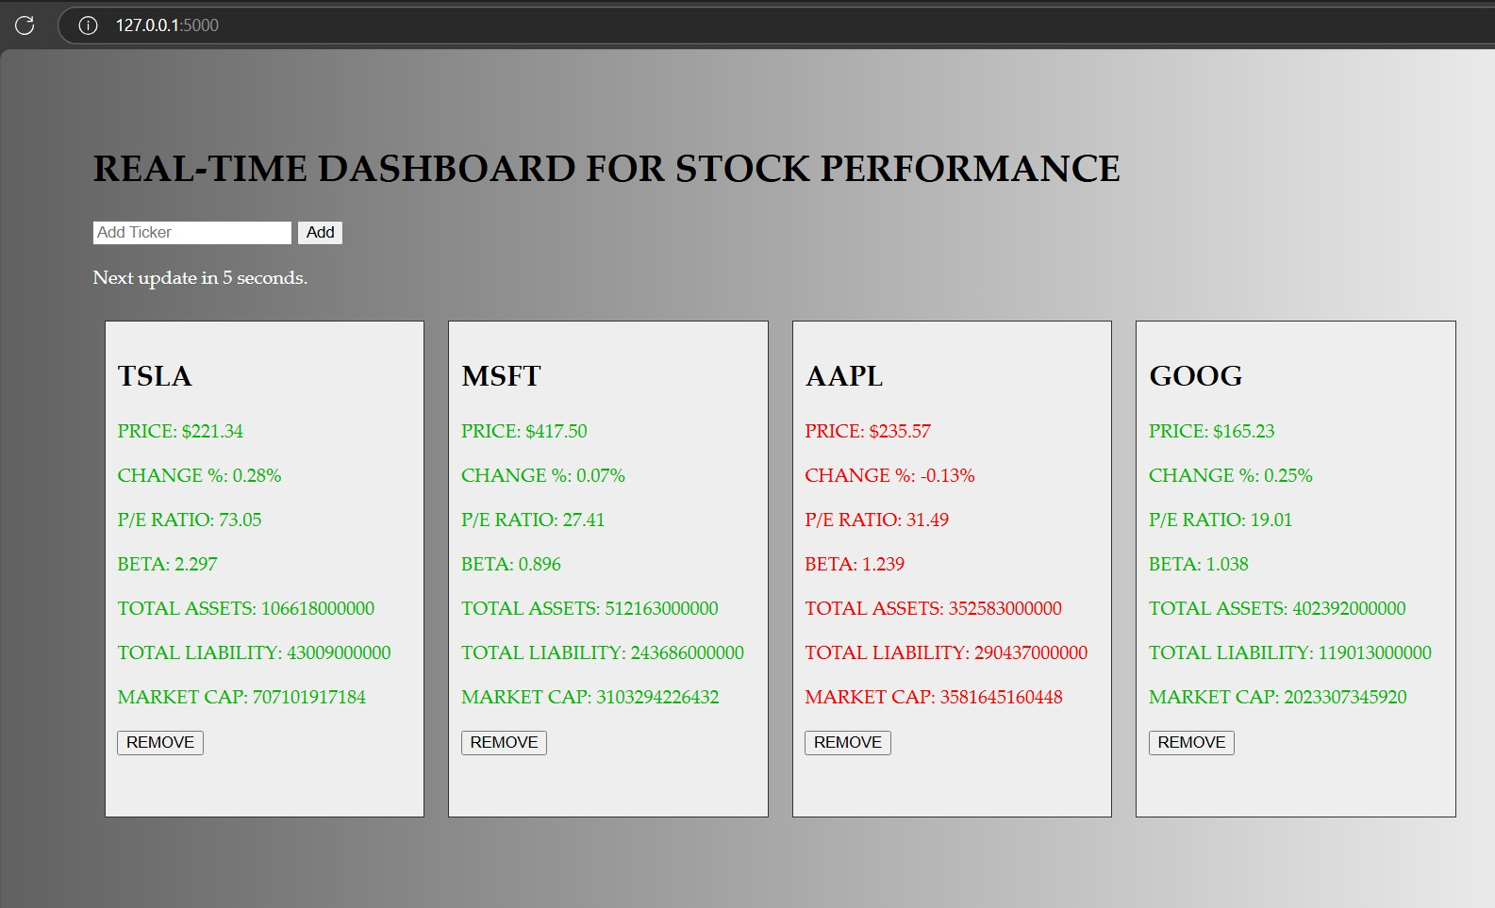
Demo

Slide 10
Scalability & Future Enhancements:
Scalability:
Easily integrates new data sources.
Supports additional asset classes and regions.
Future Enhancements:
AI-based stock prediction models.
Integration with additional ESG data providers.
Mobile app version for enhanced user accessibility.

Slide 11
Challenges and Learning
Challenges:
Handling large data volumes and ensuring real-time updates.
Balancing UI complexity with user experience.
Learnings:
Deeper understanding of financial metrics and ESG factors.
Experience in integrating diverse APIs and data sources.

Slide 12
Conclusion
Summary:
Created an innovative tool for investors focusing on sustainable investing.
Streamlined data for better decision-making and market insights.

Slide 13
Thanks!

